Slide 1
Reciprocal Teaching

Slide 2
Reciprocal Teaching
Purpose of Reciprocal Teaching Strategy:
Reciprocal Teaching (Palinscar & Brown 1984) is a guided reading comprehension strategy that encourages students to develop the skills that effective readers and learners do automatically (summarize, question, clarify, and predict).
Students use these four comprehension strategies on a common text, in pairs or small groups. Reciprocal Teaching can be used with fiction, non-fiction, prose or poetry.

Slide 3
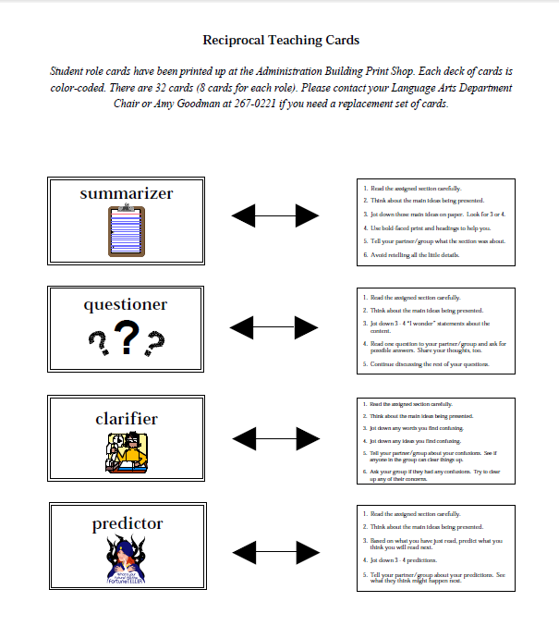

Slide 4
Restate the text in your own words.
Explain what you read in two or three sentences.

Slide 5
Ask one on- and one under-the-surface question.
The answer for on-the-surface questions can be found right in the text.

Slide 6
Write down words or ideas that need to be clarified Discuss with your group.

Slide 7
Predict what is likely to happen next and later.
Give evidence for your prediction.

Slide 8
Reciprocal Teaching
“Harlem”
By Langston Hughes

Slide 9
Harlem BY LANGSTON HUGHES

Slide 10
Harlem BY LANGSTON HUGHES

Slide 11
Harlem BY LANGSTON HUGHES

Slide 12
Harlem BY LANGSTON HUGHES

Slide 13
Harlem BY LANGSTON HUGHES

Slide 14
Harlem BY LANGSTON HUGHES

Slide 15
Harlem BY LANGSTON HUGHES

Slide 16
Harlem BY LANGSTON HUGHES

Slide 17
Harlem BY LANGSTON HUGHES

Slide 18
Harlem BY LANGSTON HUGHES
What happens to a dream deferred?

Slide 19
Harlem BY LANGSTON HUGHES
What happens to a dream deferred?
Restate the text in your own words.
Explain what you read in two or three sentences.

Slide 20
Harlem BY LANGSTON HUGHES
What happens to a dream deferred?
Restate the text in your own words.
Explain what you read in two or three sentences.
Ask one on- and one under-the-surface question.
The answer for on-the-surface questions can be found right in the text.

Slide 21
Harlem BY LANGSTON HUGHES
What happens to a dream deferred?
Restate the text in your own words.
Explain what you read in two or three sentences.
Ask one on- and one under-the-surface question.
The answer for on-the-surface questions can be found right in the text.
Write down words or ideas that need to be clarified. Discuss with your group.

Slide 22
Harlem BY LANGSTON HUGHES
What happens to a dream deferred?
Restate the text in your own words.
Explain what you read in two or three sentences.
Ask one on- and one under-the-surface question.
The answer for on-the-surface questions can be found right in the text.
Predict what is likely to happen.
Give evidence for your prediction.
Write down words or ideas that need to be clarified. Discuss with your group.

Slide 23
Harlem BY LANGSTON HUGHES
What happens to a dream deferred?
Restate the text in your own words.
Explain what you read in two or three sentences.
Ask one on- and one under-the-surface question.
The answer for on-the-surface questions can be found right in the text.
Predict what is likely to happen.
Give evidence for your prediction.
Write down words or ideas that need to be clarified. Discuss with your group.

Slide 24
Harlem BY LANGSTON HUGHES
Does it dry up
like a raisin in the sun?
Or fester like a sore—
And then run?
Does it stink like rotten meat?
Or crust and sugar over—
like a syrupy sweet?
What happens to a dream deferred?
Restate the text in your own words.
Explain what you read in two or three sentences.
Ask one on- and one under-the-surface question.
The answer for on-the-surface questions can be found right in the text.
Predict what is likely to happen.
Give evidence for your prediction.
Write down words or ideas that need to be clarified. Discuss with your group.

Slide 25
Harlem BY LANGSTON HUGHES
Does it dry up
like a raisin in the sun?
Or fester like a sore—
And then run?
Does it stink like rotten meat?
Or crust and sugar over—
like a syrupy sweet?
Maybe it just sags
like a heavy load.
What happens to a dream deferred?
Restate the text in your own words.
Explain what you read in two or three sentences.
Ask one on- and one under-the-surface question.
The answer for on-the-surface questions can be found right in the text.
Predict what is likely to happen.
Give evidence for your prediction.
Write down words or ideas that need to be clarified Discuss with your group.

Slide 26
Harlem BY LANGSTON HUGHES
Does it dry up
like a raisin in the sun?
Or fester like a sore—
And then run?
Does it stink like rotten meat?
Or crust and sugar over—
like a syrupy sweet?
Maybe it just sags
like a heavy load.
Or does it explode?
What happens to a dream deferred?
Restate the text in your own words.
Explain what you read in two or three sentences.
Ask one on- and one under-the-surface question.
The answer for on-the-surface questions can be found right in the text.
Predict what is likely to happen.
Give evidence for your prediction.
Write down words or ideas that need to be clarified Discuss with your group.

Slide 27
Making a Fist by Naomi Shihab Nye
Restate the text in your own words.
Explain what you read in two or three sentences.
Ask one on- and one under-the-surface question.
The answer for on-the-surface questions can be found right in the text.
Predict what is likely to happen.
Give evidence for your prediction.
Write down words or ideas that need to be clarified Discuss with your group.

Slide 28
Making a Fist by Naomi Shihab Nye
For the first time, on the road north of Tampico,
I felt the life sliding out of me,
a drum in the desert, harder and harder to hear.
I was seven, I lay in the car
watching palm trees swirl a sickening pattern past the glass.
My stomach was a melon split wide inside my skin.
Restate the text in your own words.
Explain what you read in two or three sentences.
Ask one on- and one under-the-surface question.
The answer for on-the-surface questions can be found right in the text.
Predict what is likely to happen.
Give evidence for your prediction.
Write down words or ideas that need to be clarified Discuss with your group.

Slide 29
Making a Fist by Naomi Shihab Nye
For the first time, on the road north of Tampico,
I felt the life sliding out of me,
a drum in the desert, harder and harder to hear.
I was seven, I lay in the car
watching palm trees swirl a sickening pattern past the glass.
My stomach was a melon split wide inside my skin.
"How do you know if you are going to die?"
I begged my mother.
We had been traveling for days.
With strange confidence she answered,
"When you can no longer make a fist."
Restate the text in your own words.
Explain what you read in two or three sentences.
Ask one on- and one under-the-surface question.
The answer for on-the-surface questions can be found right in the text.
Predict what is likely to happen.
Give evidence for your prediction.
Write down words or ideas that need to be clarified Discuss with your group.

Slide 30
Making a Fist by Naomi Shihab Nye
For the first time, on the road north of Tampico,
I felt the life sliding out of me,
a drum in the desert, harder and harder to hear.
I was seven, I lay in the car
watching palm trees swirl a sickening pattern past the glass.
My stomach was a melon split wide inside my skin.
"How do you know if you are going to die?"
I begged my mother.
We had been traveling for days.
With strange confidence she answered,
"When you can no longer make a fist."
Years later I smile to think of that journey,
the borders we must cross separately,
stamped with our unanswerable woes.
I who did not die, who am still living,
still lying in the backseat behind all my questions,
clenching and opening one small hand.
Restate the text in your own words.
Explain what you read in two or three sentences.
Ask one on- and one under-the-surface question.
The answer for on-the-surface questions can be found right in the text.
Predict what is likely to happen.
Give evidence for your prediction.
Write down words or ideas that need to be clarified Discuss with your group.

